Slide 1

AWS Systems Operations 21 May 2019 Fernando Pombeiro

Slide 2
Cloudwatch

Slide 3
Infrastructure philosophy
Logging and bug hunting is essential to any stack. One of the biggest advantages of using AWS for deploying and maintaining infrastructure is that logging is built in to the AWS infrastructure.
This built in logging is known as cloudwatch and can be provisioned and utilized and managed via terraform.

Slide 4
Cloudwatch in terraform
Go into your aws console and take a look at some of our previously deployed resources- specifically the EC2 webserver instance that we deployed
Go down to the bottom of the screen and look at the Monitoring tab. You should see a bunch of charts there that demonstrate everything from CPU Utilization to Network IN, Disk Reads and Disk Writes, and Packets.

Slide 5
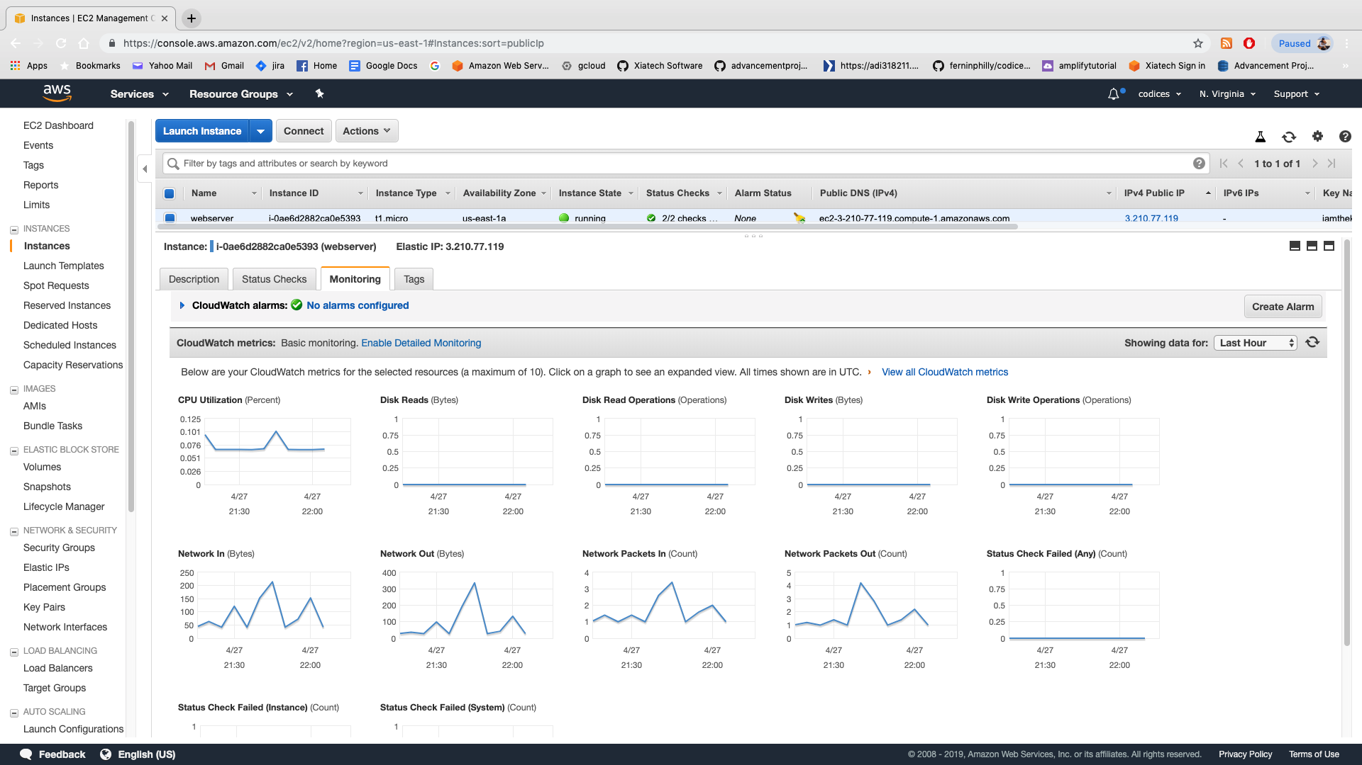
Cloudwatch (continued)

Slide 6
Cloudwatch (continued)
Note that you can look at different time ranges.
BUT- cloudwatch is MUCH more than just charts! You can also use cloudwatch to log issues sent to STDOUT and STDERR from an application.
So we can read items sent from console.log, print, Printf, etc… to the log. We can also filter these items. In the lab we’ll be deploying an application that does nothing but print out items.

Slide 7
Cloudwatch logs (continued)

Slide 8
Cloudwatch Logs
Cloudwatch logging should be the first place your developers go when they are looking for issues.
Speaking from personal experience- I’d recommend having your dev team log out to stdout frequently to keep track of the flow of the application.
All STDOUT errors and stack traces will also appear in cloudwatch logs- which you can have devs look at directly or forward directly to them.
Finally- SYSTEM logs (what DEVOPS are interested in) and APPLICATION logs are different.

Slide 9
Cloudtrail agent
So- along with cloudwatch at the application level there is also an add-on known as cloudtrail which is basically cloudwatch but on the AWS account level.
Every event that occurs on your AWS account (provision an EC2 instance, log in to the console, etc…) can be sent as a log to an S3 bucket where you can then access it through an api interface.
This is a good thing for the senior sys-ops personnel to use to monitor use (and costs) of AWS resources.

Slide 10
Cloudwatch trail (completion)
Although cloudtrail is outside of the scope of deploying and managing applications it’s worth studying up on if you are the senior sys-ops.
AWS costs get out of control pretty quickly and from personal experience I’d suggest setting up cloudwatch alarms for certain activities (like creating Redshift instances at $150 per month a pop) and DynamoDB tables ($5k a pop).

Slide 11
Cloudwatch Alarms
Another advantage of cloudwatch is that we can set up alarms in AWS that will notify the team when certain activities occur in an application.
In the example of a web application we can set up alarms that notify us if there are more than three 404 errors in 5 minutes or a system overload or anything like that.

Slide 12
Cloudwatch Alarms (continued)
You can set cloudwatch alarms with text recognition to notify a person or group depending on the type of text that comes in on the logs (we’ll be doing this in the upcoming lab).
This allows us the flexibility to customize the alarm depending on the error handling being used by your coders.

Slide 13
Cloudwatch alarms and SS
So- while cloudwatch alarms will notify you as to what is happening…the next logical question is “notify WHO?...and HOW?”.
The answer to this is another AWS service that we can use for multiple resources: the AWS Simple Notification Service.
SNS can be used for notifications from most services but in this case we’ll be hooking it up to cloudformation.

Slide 14
Simple Notification Service

Slide 15
PUB/SUB
So the AWS Simple Notification Service is basically a publish/subscribe (pub/sub) service in AWS.
The service can send messages between various AWS resources based on the existence of an event. This makes it a key component of event driven architecture.
Although we’ll be utilizing SNS to send messages based on cloudformation events… this is just ONE of the events we can use to trigger messages.

Slide 16
Simple Notification Service

Slide 17
SNS Topics
SNS publishes messages to TOPICS- which are what the client subscribes to.
So we’ll set up a TOPIC based on each type of cloudwatch alarm we want to create (for example “404 errors” or something.

Slide 18
SNS Broader context
So TOPICS can be used for multiple triggers in your AWS infrastructure. Think of SNS as the glue that holds all of the microservices in your infrastructure together: it’s a convenient way to pass messages between resources and ensure that you retain your event driven architecture.
In the lab we’re going to create a topic to send an email and text message based on a string pattern in cloudwatch.

Slide 19
Lambdas

Slide 21
Confused????
GOOD! Ask Questions!!

